Slide 1

P. O. S.
Transactions
Click to Begin

Slide 2
Error!
Please follow the on-screen
instructions to continue.
Go Back

Slide 3
Complete
Please navigate to the next module
in the course to continue.
Restart Course

Slide 4
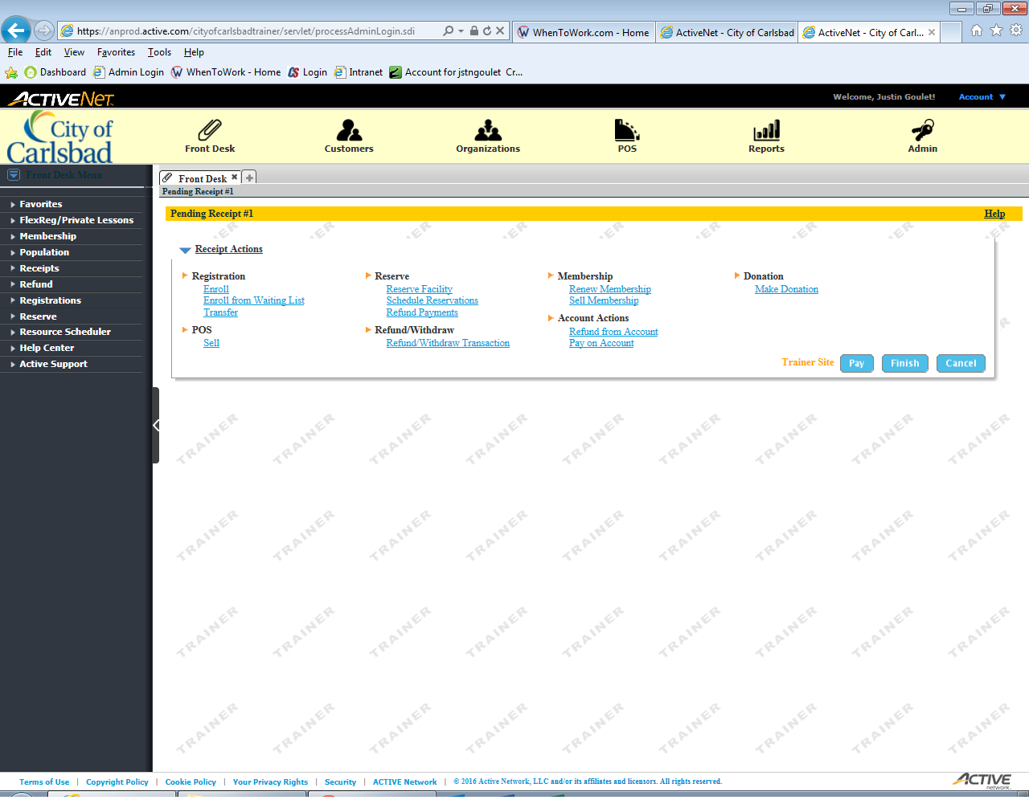
Tip:
Main Text Instruction Will Go Here
Open the POS module
Sub Instruction Here

Slide 5
Merchandise
&
Food / Beverage
Snack Bar, Concessions
Facilities
&
Special Events
Open Play, Special Events Ticketing
Select
Select
Tip:
Click Select for your common transactions.
If you work at a facility such as Calavera, Stagecoach or Harding, select Facilities
If you work at a facility such as Alga Norte or Monroe, select Merchandise.

Slide 6
Error!
Please follow the on-screen
instructions to continue.
Go Back

Slide 7
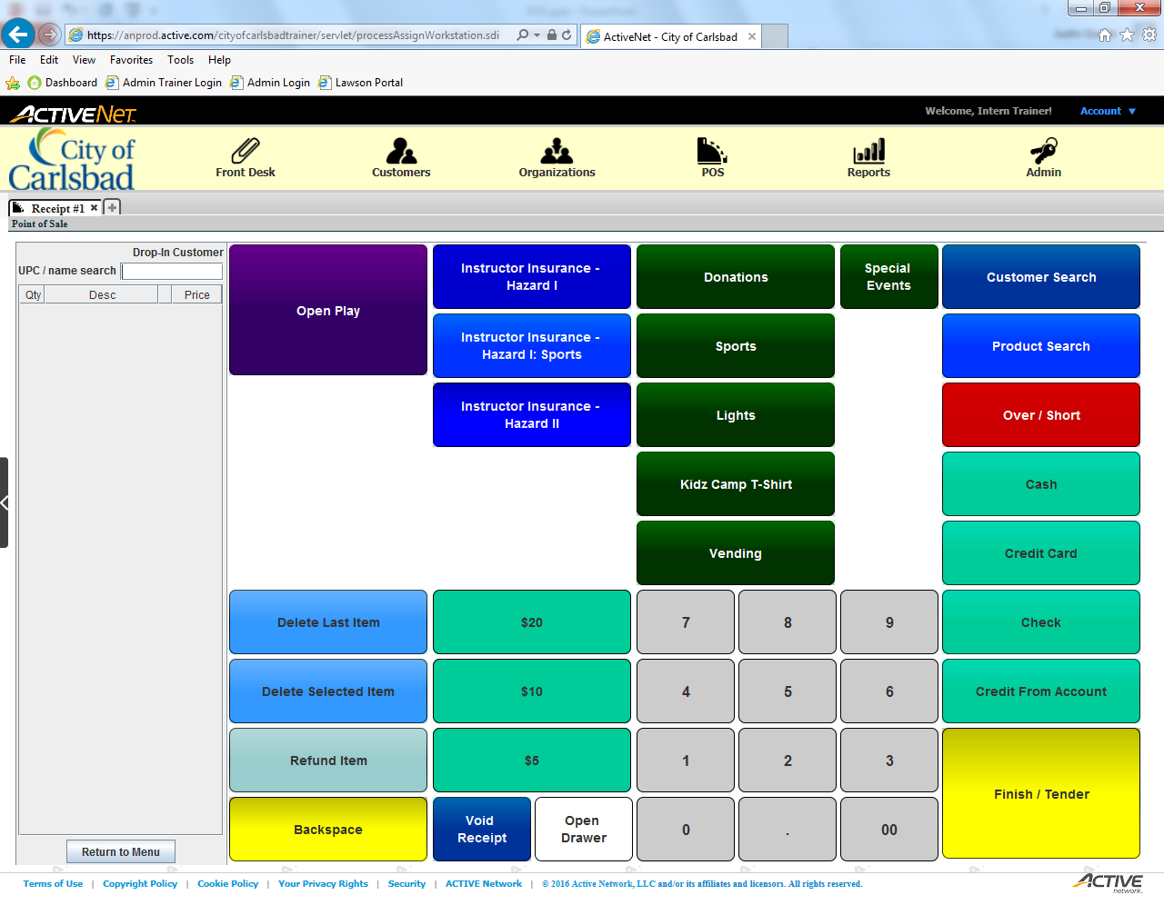
Tip:
Main Text Instruction Will Go Here
Select Open Play
Sub Instruction Here

Slide 8
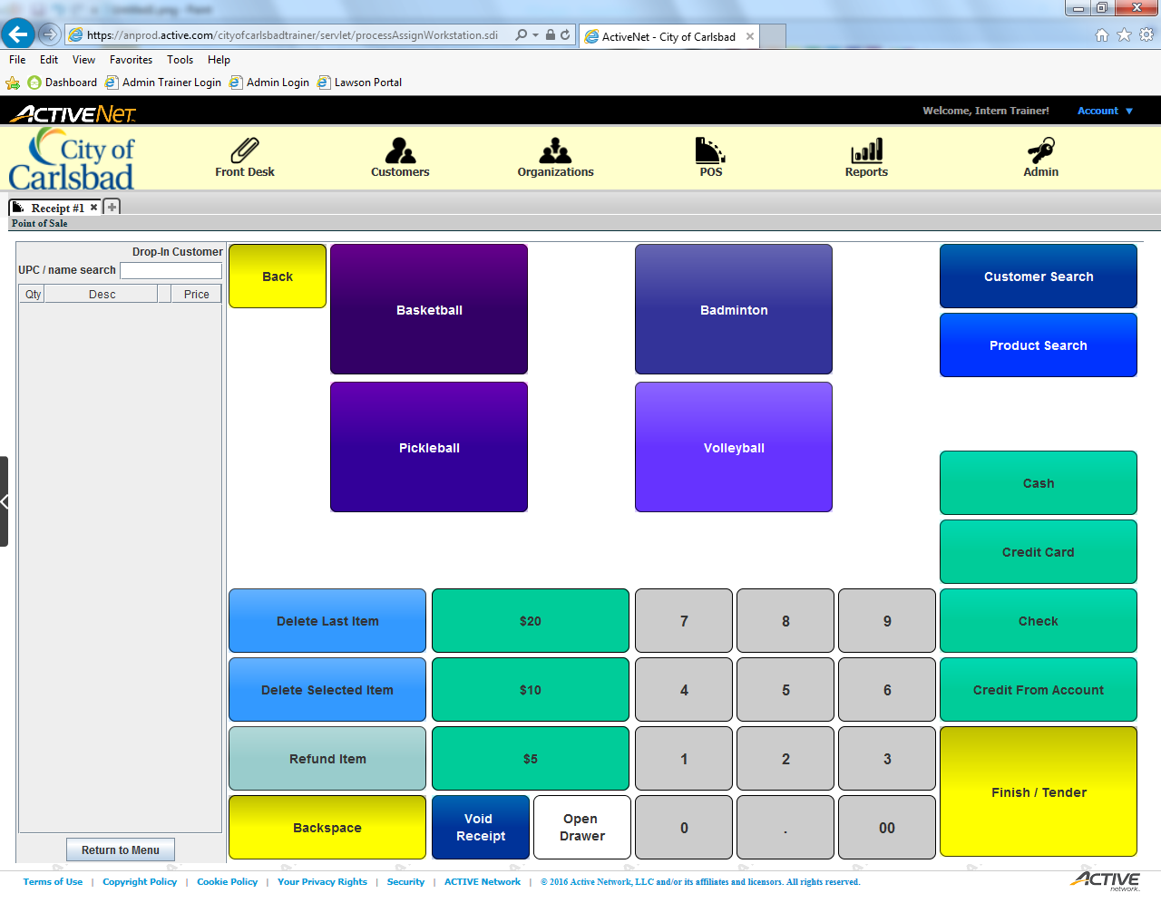
Tip:
Main Text Instruction Will Go Here
Select the amount of players
Sub Instruction Here

Slide 9

Tip:
Main Text Instruction Will Go Here
Select the current activity
Sub Instruction Here

Slide 10

Tip:
Main Text Instruction Will Go Here
Select the cost. It is currently $3 for all players.
Sub Instruction Here

Slide 11

Tip:
Main Text Instruction Will Go Here
Add 2 more players.
Sub Instruction Here

Slide 12

Tip:
Main Text Instruction Will Go Here
Enter the cost in again ($3).
Sub Instruction Here

Slide 13

Tip:
Main Text Instruction Will Go Here
Accept the input.
Sub Instruction Here

Slide 14

Tip:
Main Text Instruction Will Go Here
Delete the most recent addition.
Sub Instruction Here

Slide 15
Tip:
Main Text Instruction Will Go Here
Start the cash transaction.
Sub Instruction Here

Slide 16

Tip:
Main Text Instruction Will Go Here
Accept the input. Modify payment amount if needed.
Sub Instruction Here

Slide 17

Tip:
Main Text Instruction Will Go Here
Finish the transaction.
Sub Instruction Here

Slide 18
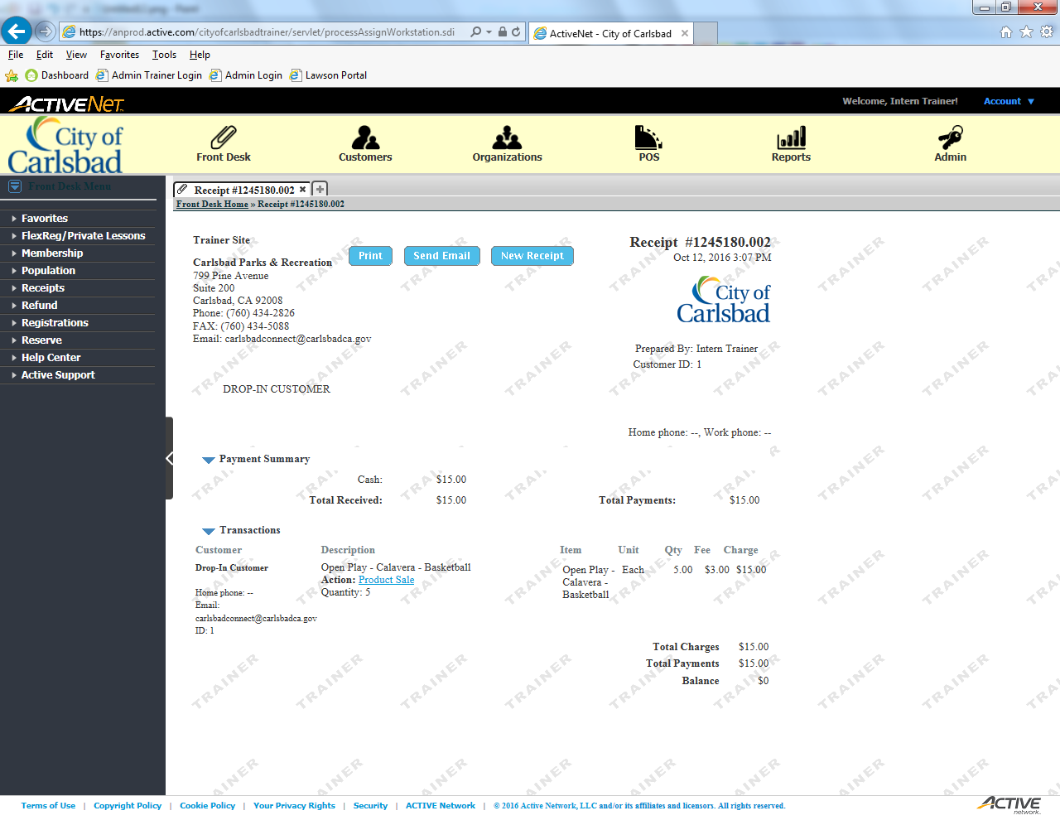
Tip:
Main Text Instruction Will Go Here
Open the POS module
Sub Instruction Here

Slide 19
Tip:
Main Text Instruction Will Go Here
Select a Kidz Camp t-shirt.
Sub Instruction Here

Slide 20

Tip:
Main Text Instruction Will Go Here
Search for a customer.
Sub Instruction Here

Slide 21
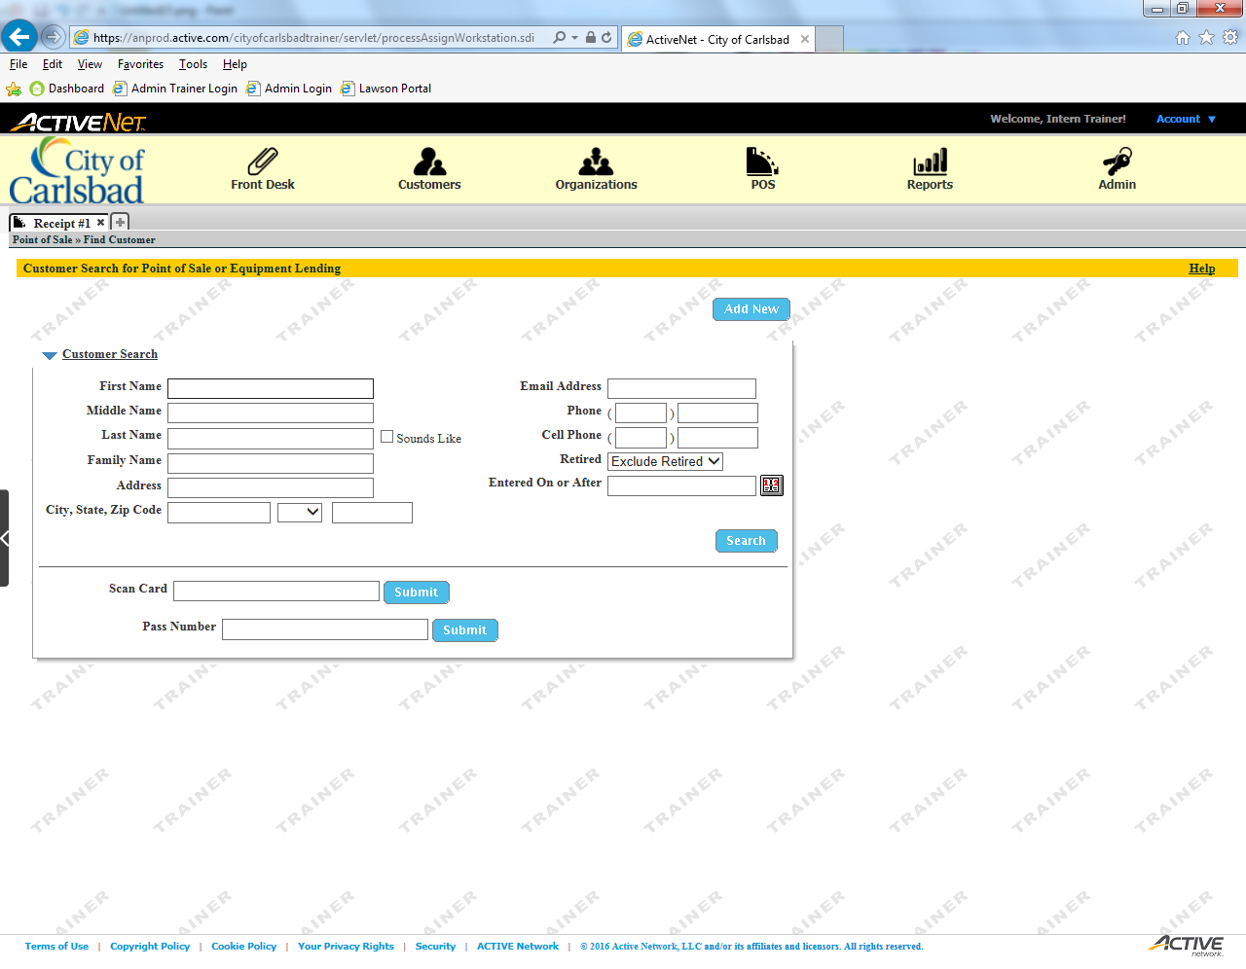
Tip:
Main Text Instruction Will Go Here
Enter the client’s First Name.
Sub Instruction Here

Slide 22
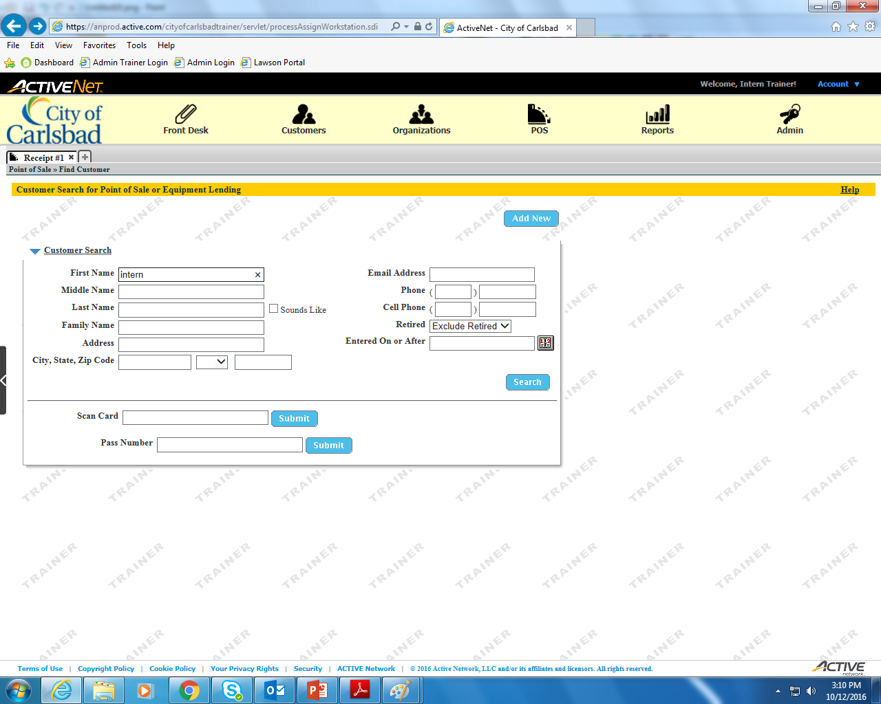
Tip:
Main Text Instruction Will Go Here
Enter the client’s Last Name.
Sub Instruction Here

Slide 23
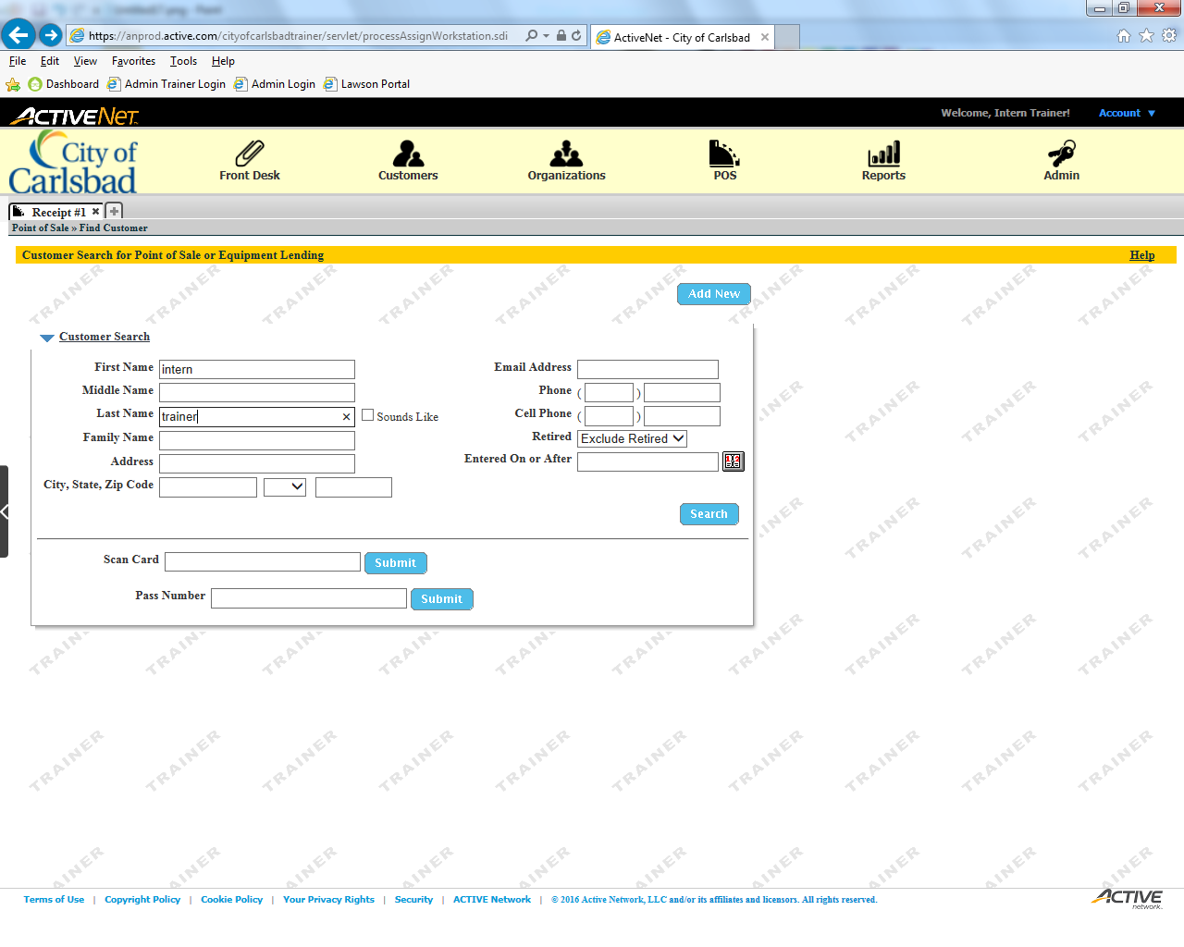
Tip:
Main Text Instruction Will Go Here
Search for the client.
Sub Instruction Here

Slide 24
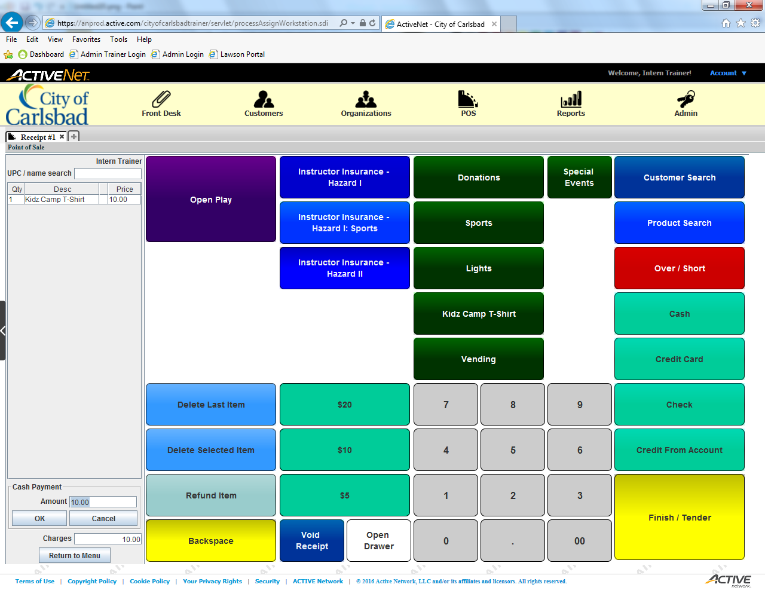
Tip:
Main Text Instruction Will Go Here
Start the Cash transaction.
Sub Instruction Here

Slide 25
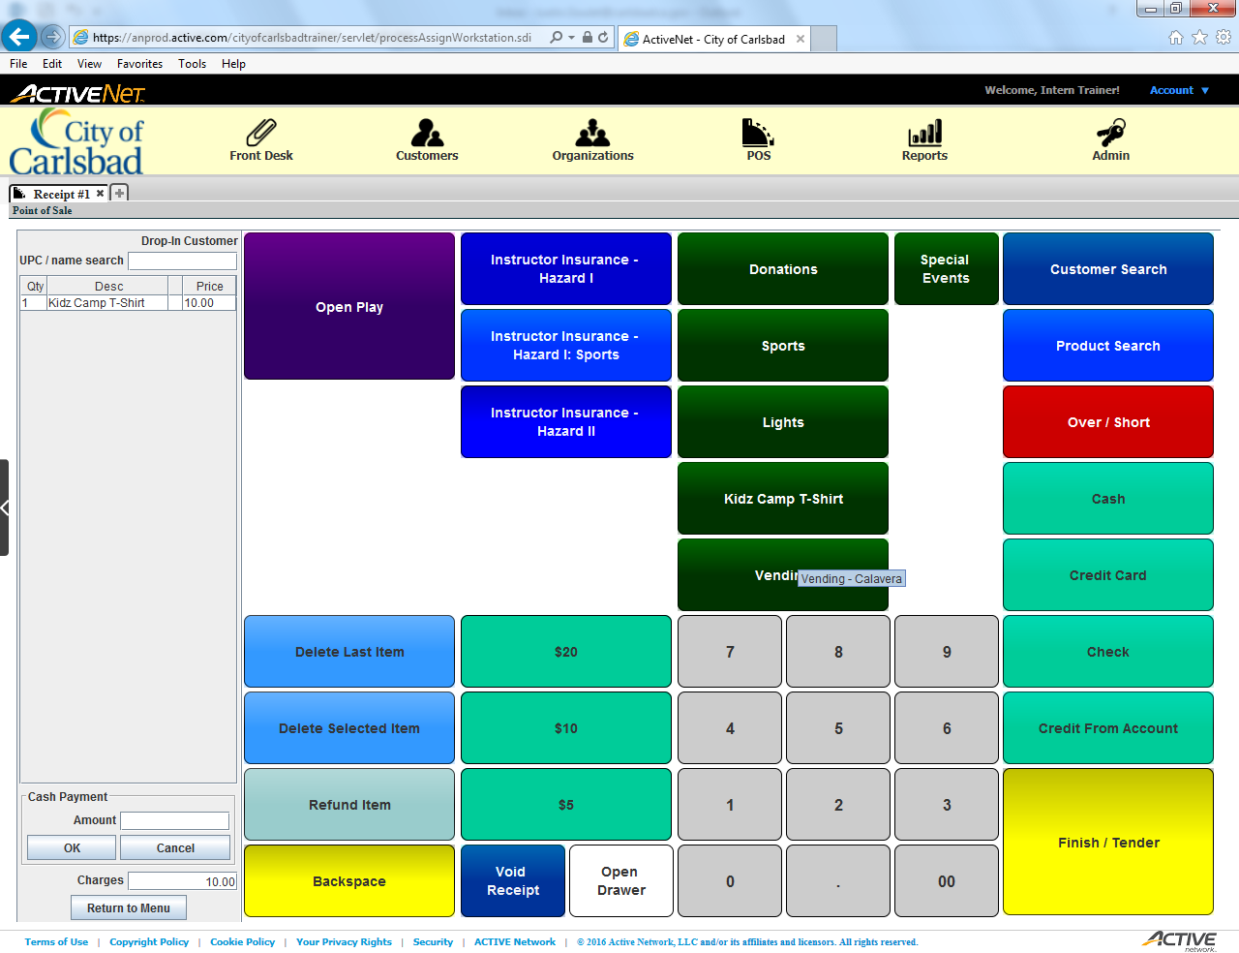
Tip:
Main Text Instruction Will Go Here
Enter the balance the client paid ($20)
Sub Instruction Here

Slide 26

Tip:
Main Text Instruction Will Go Here
Click OK to accept the amount paid.
Sub Instruction Here

Slide 27
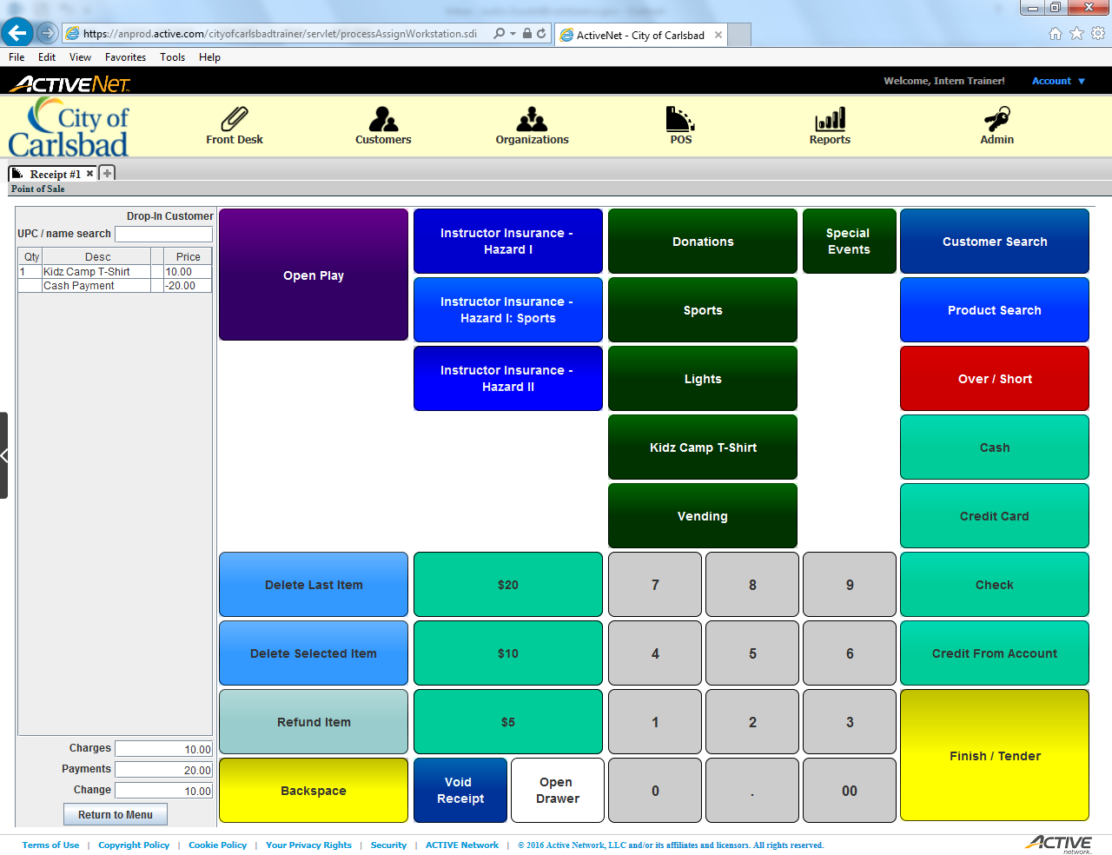
Tip:
Main Text Instruction Will Go Here
Provide the correct change and finish the transaction.
Sub Instruction Here

Slide 28
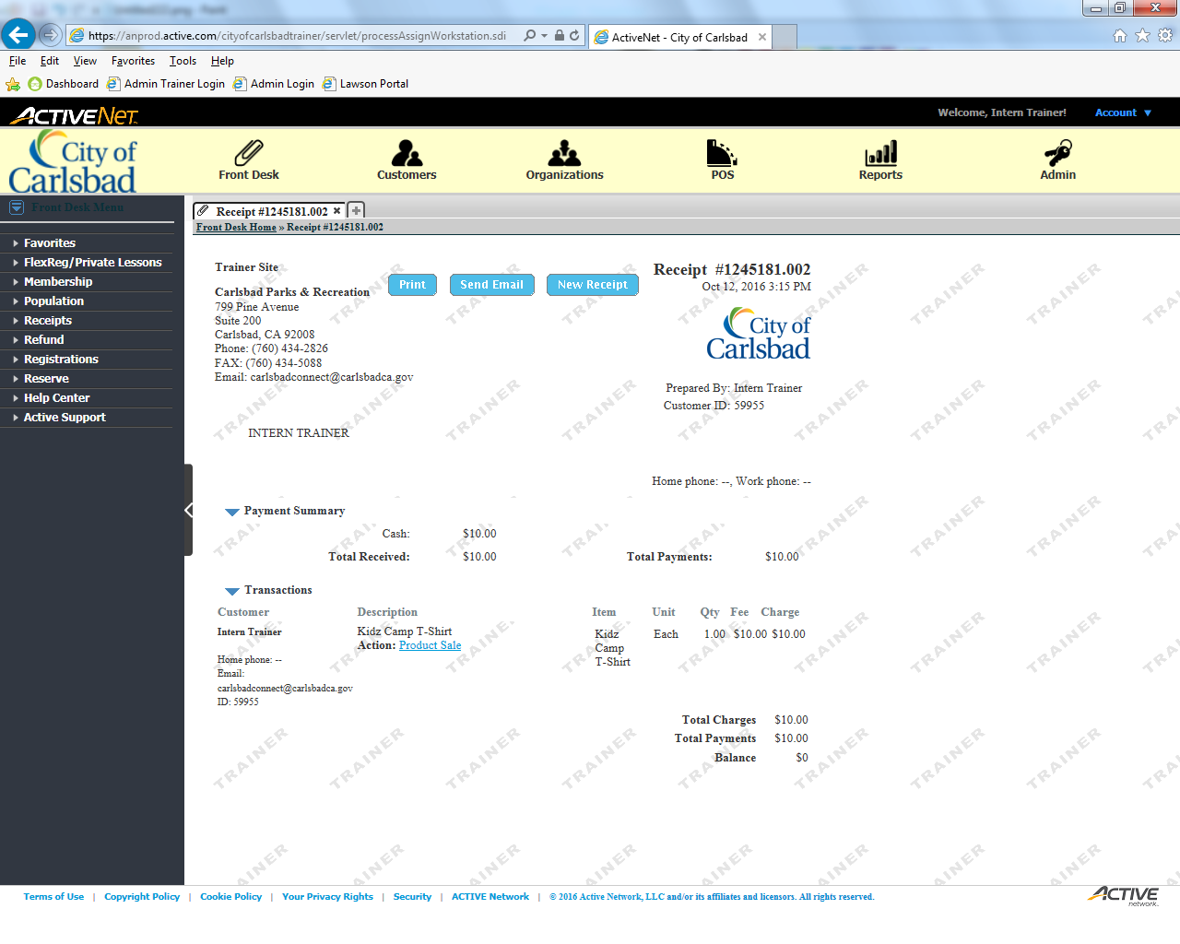
Tip:
Main Text Instruction Will Go Here
Send the email to the client. –If requested.
Sub Instruction Here

Slide 29
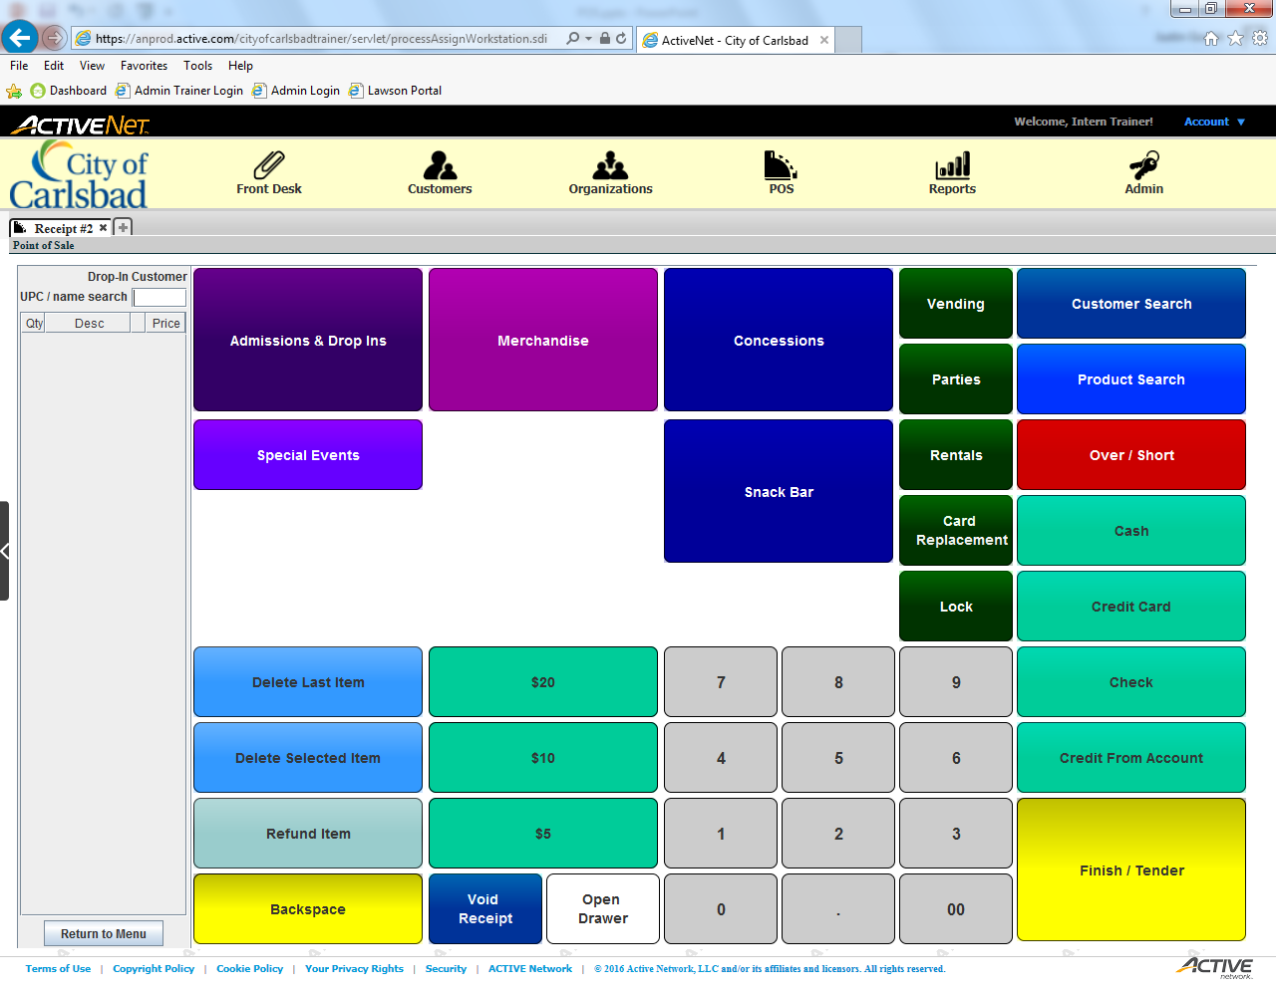
Tip:
Main Text Instruction Will Go Here
Select Concessions.
Sub Instruction Here

Slide 30
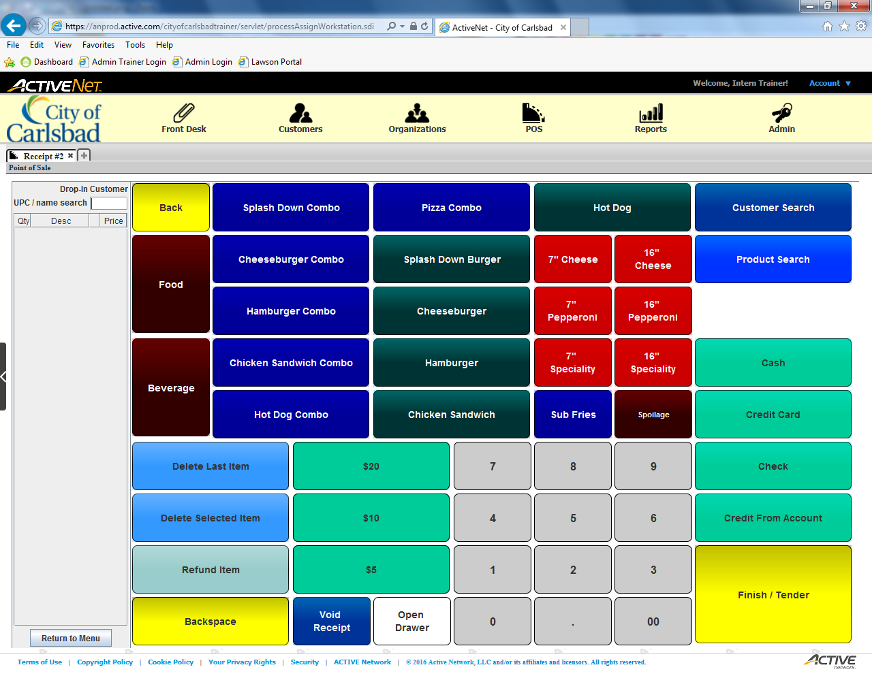
Tip:
Main Text Instruction Will Go Here
Select a Hamburger Combo.
Sub Instruction Here

Slide 31

Tip:
Main Text Instruction Will Go Here
Add another Hamburger Combo.
Sub Instruction Here

Slide 32

Tip:
Main Text Instruction Will Go Here
Delete the duplicate item.
Sub Instruction Here

Slide 33
Tip:
Main Text Instruction Will Go Here
Start the cash transaction.
Sub Instruction Here

Slide 34
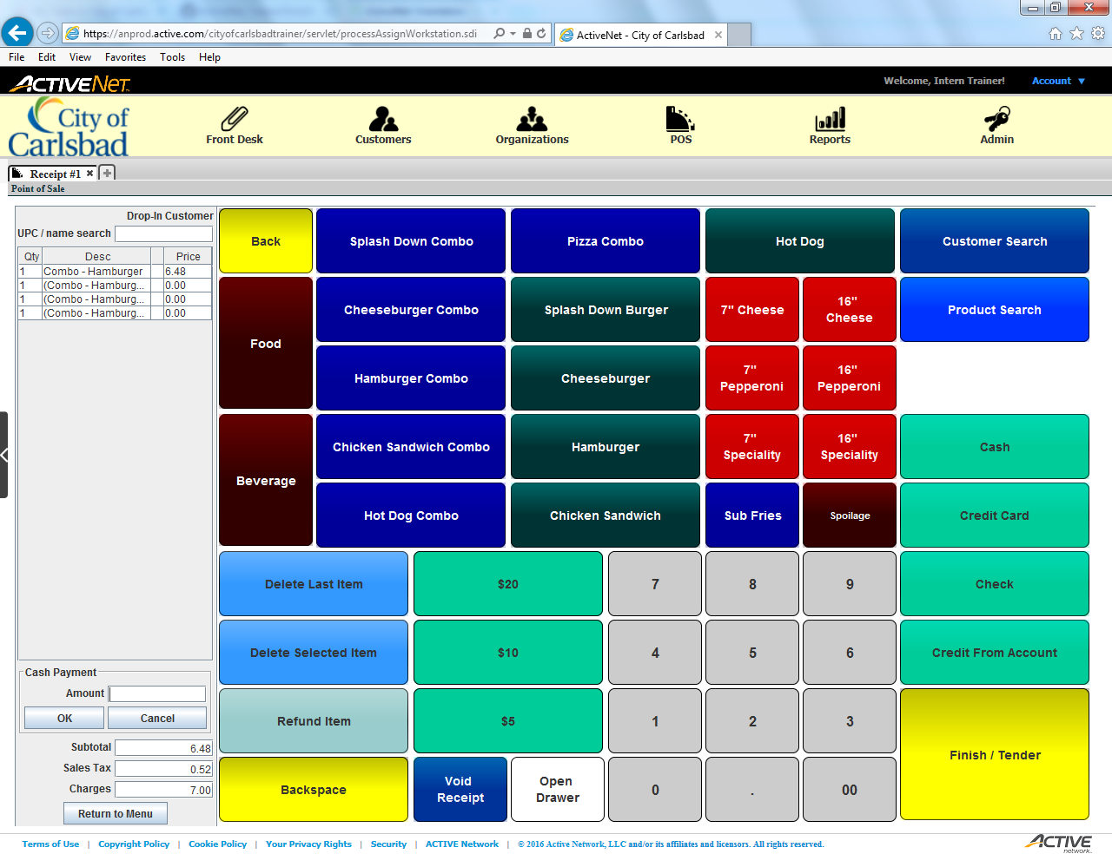
Tip:
Main Text Instruction Will Go Here
Enter the balance the client just paid ($20)
Sub Instruction Here

Slide 35

Tip:
Main Text Instruction Will Go Here
Click OK to confirm the amount paid
Sub Instruction Here

Slide 36

Tip:
Main Text Instruction Will Go Here
Provide the correct change then finish the transaction.
Sub Instruction Here

Slide 37
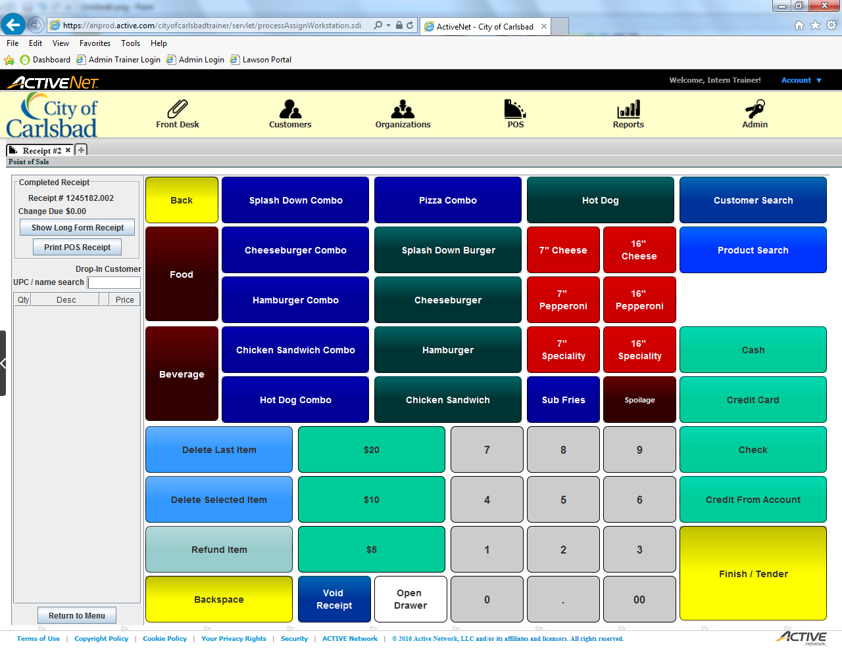
Tip:
Main Text Instruction Will Go Here
Print the receipt.
You may print the default receipt (long) or a basic receipt using the provided printer.
Sub Instruction Here

Slide 38
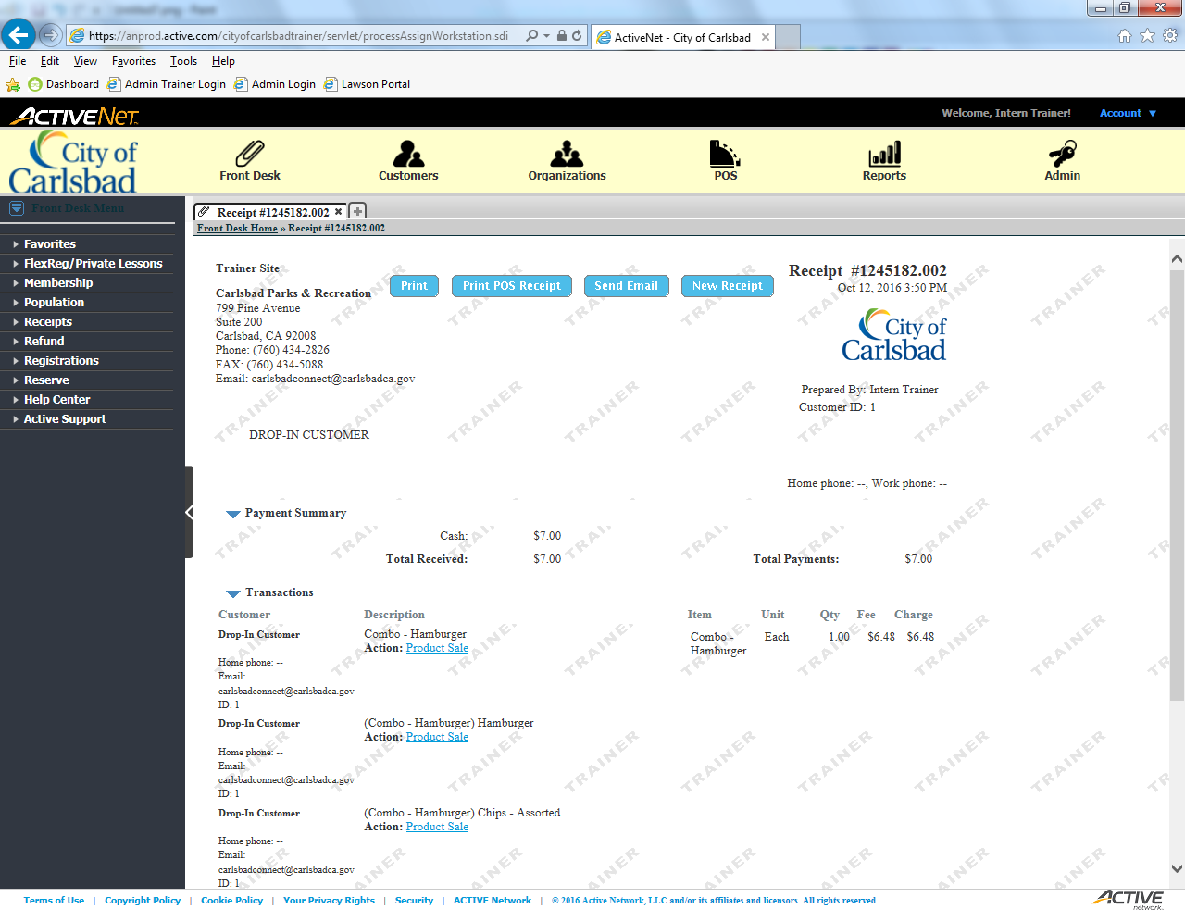
Tip:
Main Text Instruction Will Go Here
Now, print the short version.
Sub Instruction Here

